Slide 1

Big Data & Information System
IS669 – Group Project
Flight Delay Prediction

Slide 2

YOGESH VARADHARAJ BIG DATA PROJECT
YEAR-2006

Slide 3
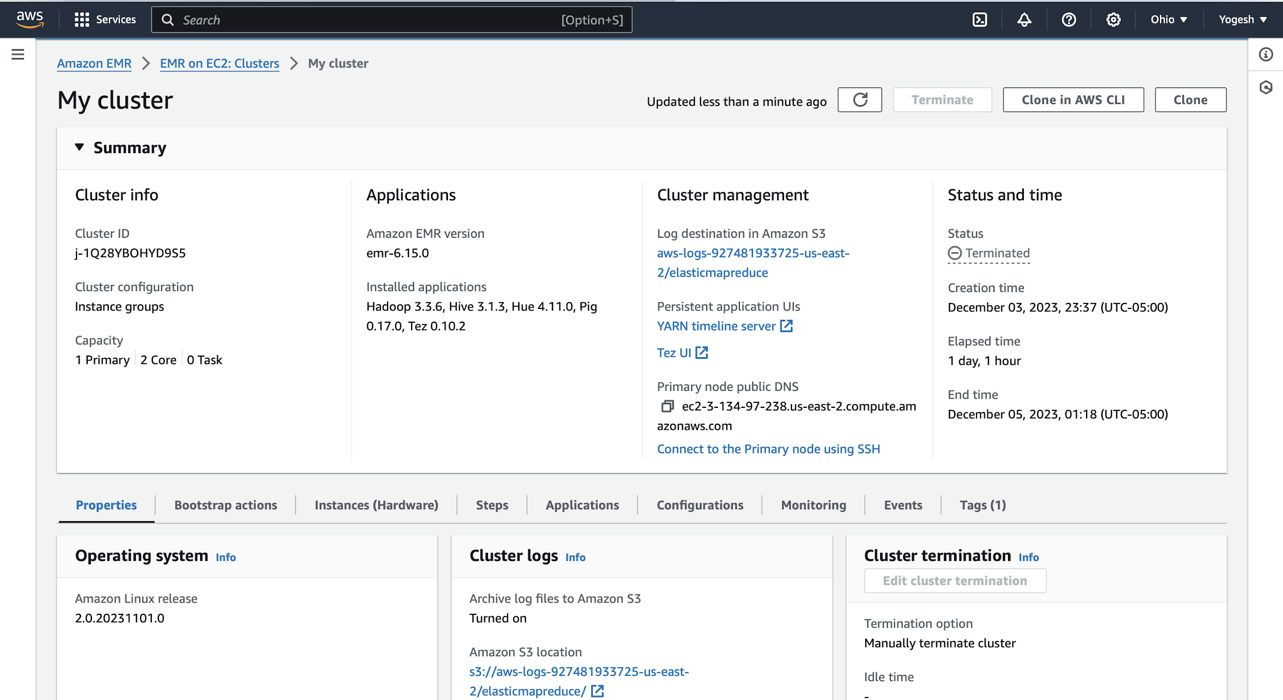
CLUSTER CREATION

Slide 4
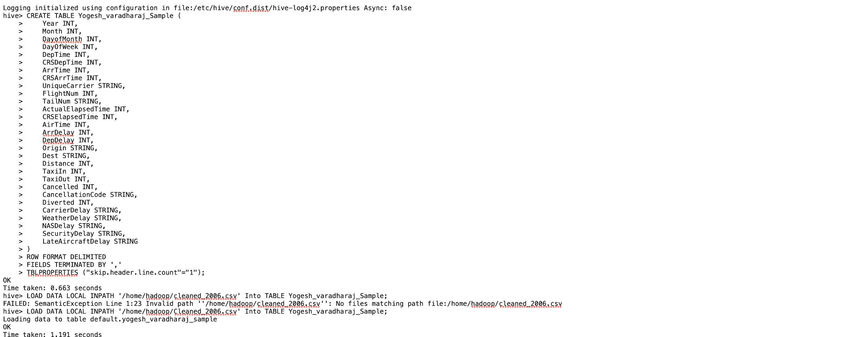
UPLOADING THE FILE
Creating Hive table

Slide 5
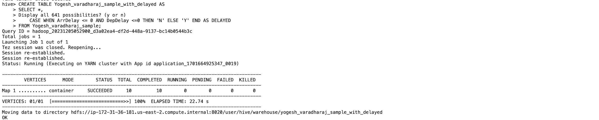
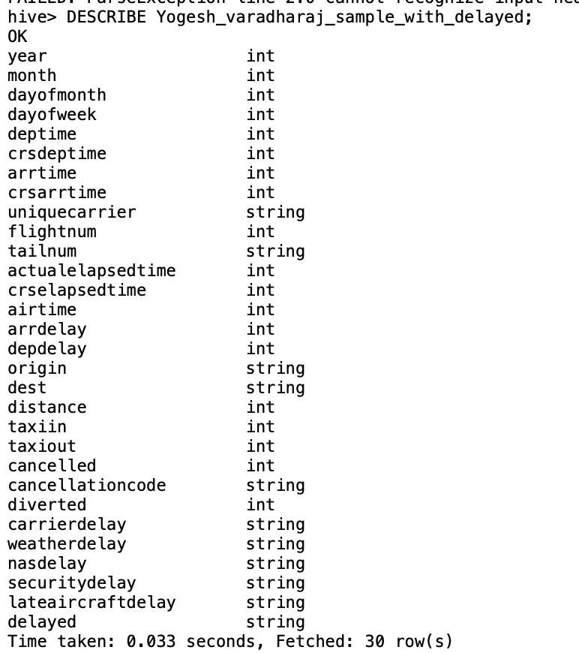
ADDING DELAYED COLUMN

Slide 6
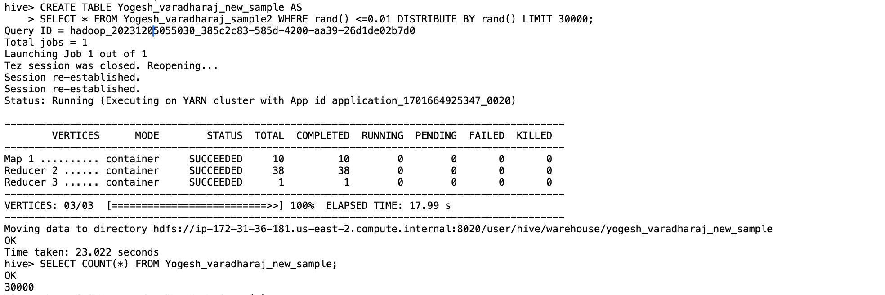
RANDOM SAMPLING CREATED A TABLE WHICH CONTAINS 30K ROWS.

Slide 7
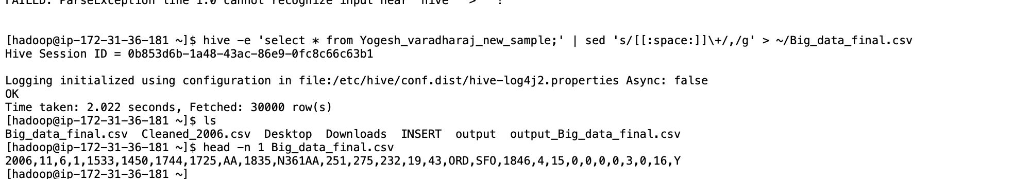
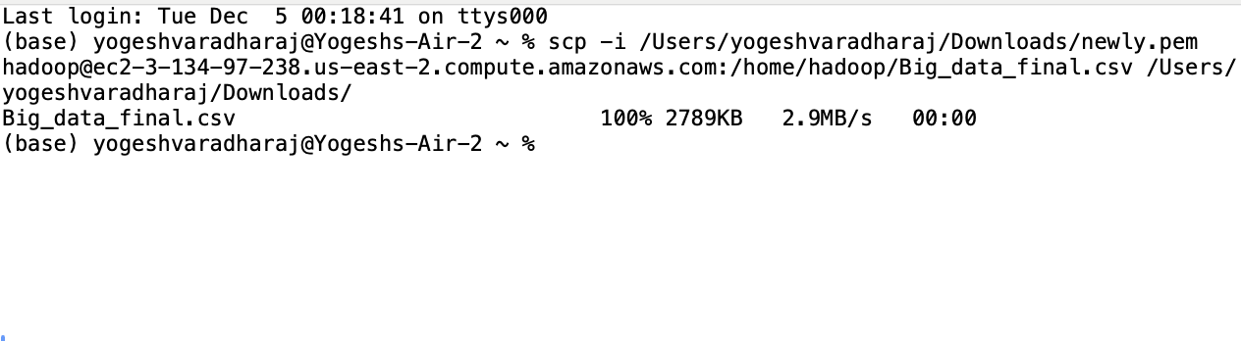
SAVED THE FILE IN HADOOP DIRECTORY
Used SCP to Download the file to my local machine

Slide 8
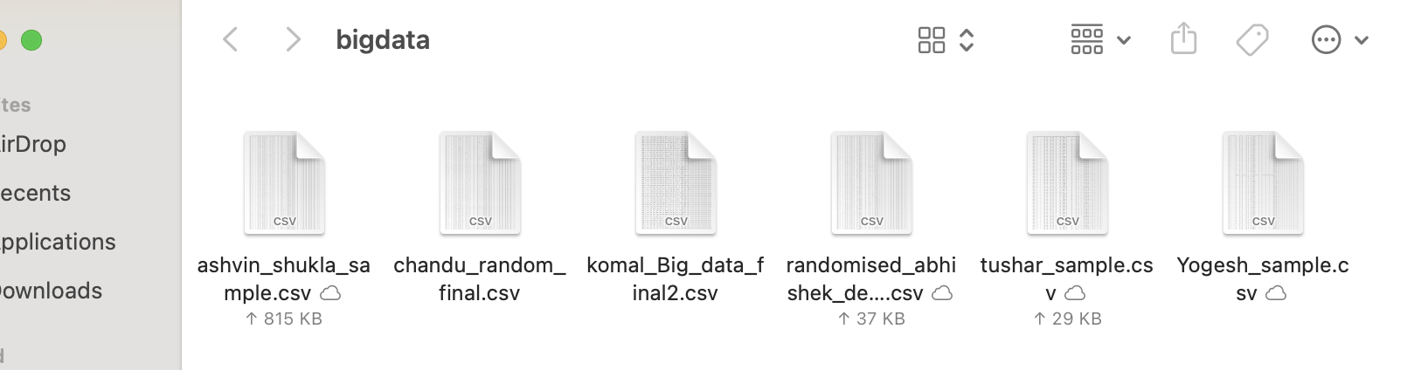
CSV FILES OF ALL GROUPMATES

Slide 9
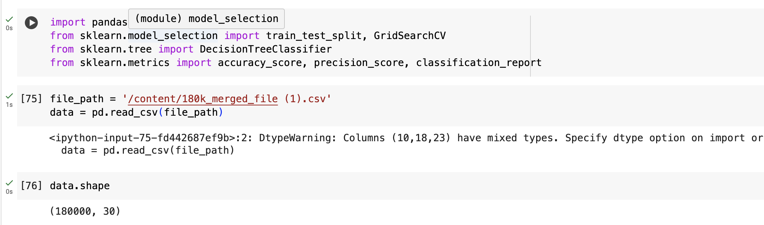
MACHINE LEARNING USING DECISION TREE USING PYTHON
Imported all the required Libraries and reading the file using Pandas. And verifying the Data size with Data.shape

Slide 10
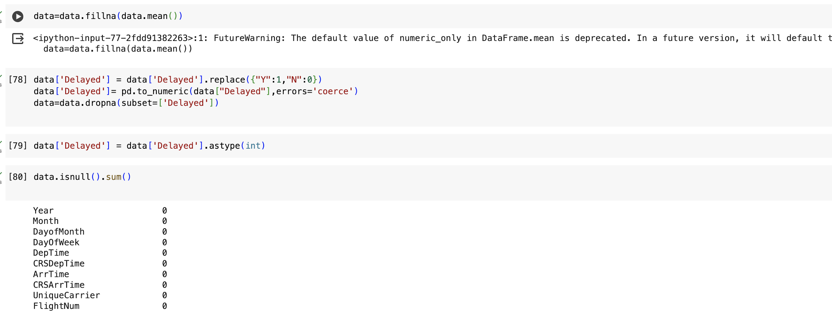
DATA CLEANING
Filled all null numerical column with mean and changed categorical columns to numerical.

Slide 11
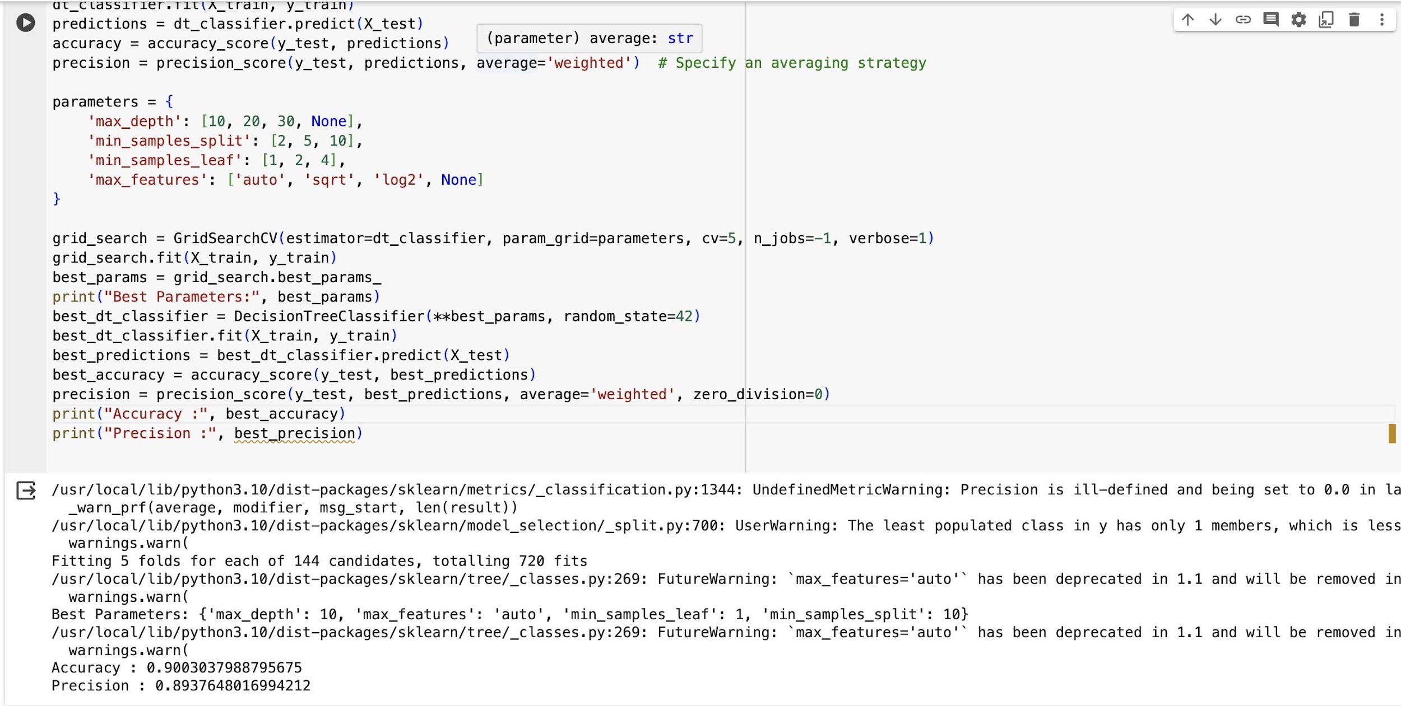
APPLYING DECISION TREE CLASSIFIER ML MODEL
Achieved 90% Accuracy and Precision

Slide 12
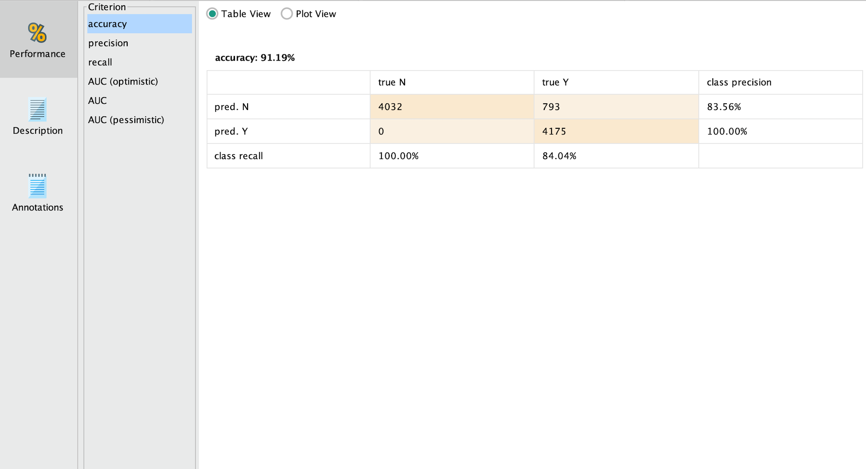
Similar Accuracy achieved in Rapid Miner

Slide 13
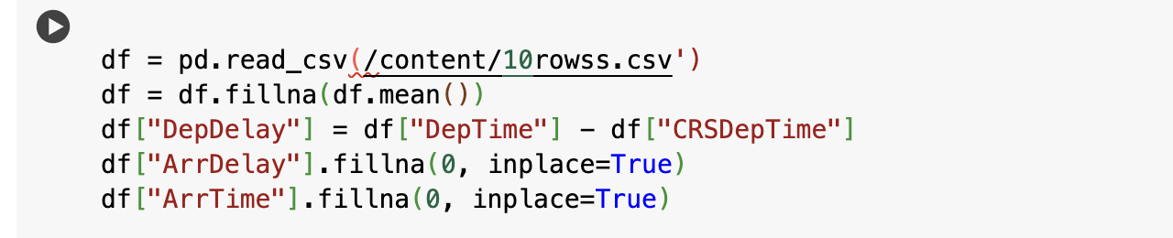
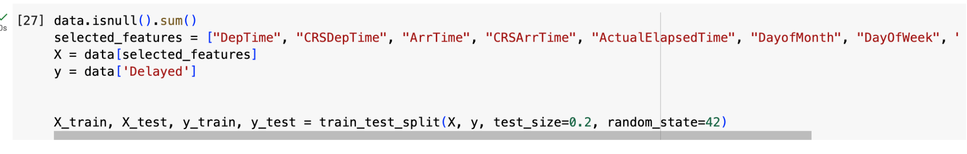
PREDICTION OF DELAYED COLUMN FOR THE DATASET PROVIDED BY PROFESSOR
Importing the data, cleaning the null values and calculating DepDelay
Prediction Of delayed Column

Slide 14
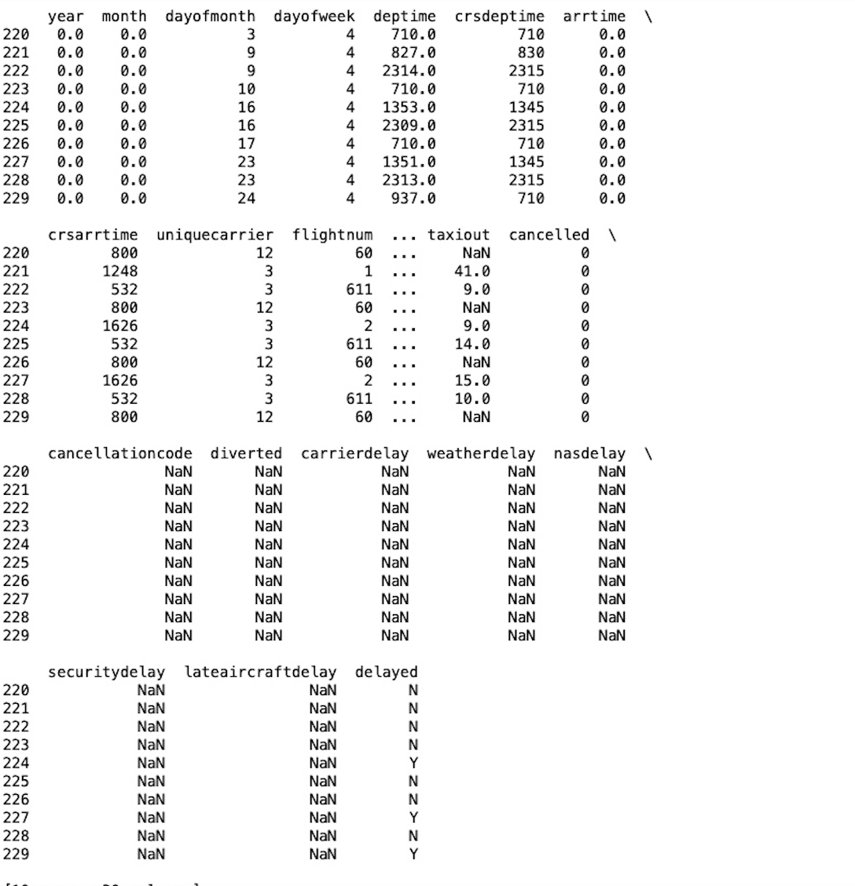
Predicted Delayed Column Using Decision Tree Classifier

Slide 15
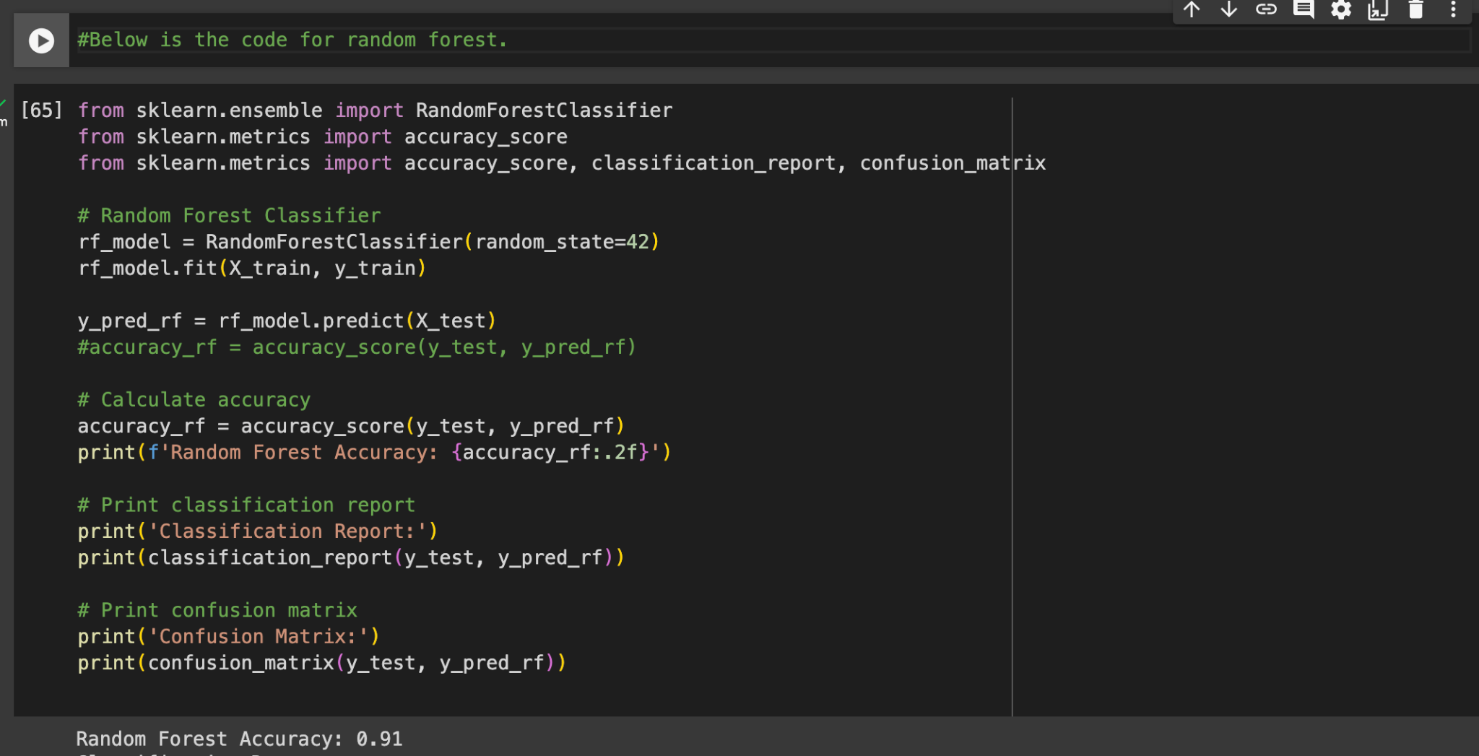
Random forest Model was chosen by the team as it had the highest accuracy, I used that model and achieved accuracy of 91%.

Slide 16
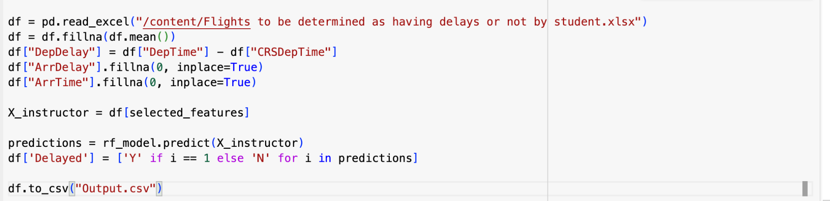
Using Random forest, I predicted the delayed column which was the same output as Decision Tree Classifier.

Slide 17
Thank You!

